Slide 1
Car Accident Severity Classification
Askhat Yktybaev
Flatiron School
2020

Slide 2
QUESTIONS ASKED
Q1: Can we predict (classify) serious and fatal car accidents?
Q2: What factors or conditions contribute to severity of car accidents?

Slide 3
Data
Detailed road safety data about the circumstances of personal injury road accidents in UK in 2018, published by central government of UK.
TARGET Variable: Accident_Severity (Slight, Serious, Fatal)
FEATURES: More than 30 variables, describing Types and Number of vehicles involved, Consequential casualties, Age, Sex, Speed limits, Road & Weather Conditions, etc.
Source: https://data.gov.uk/dataset/cb7ae6f0-4be6-4935-9277-47e5ce24a11f/road-safety-data

Slide 4
Exploratory Data Analysis
Preliminary EDA showed:
Presence of TARGET Variable imbalance problem
TARGET Variable highly correlates with ‘Casualty_Severity’ variable
Visualisation: high impact of some FEATURES: Urban_vs_Rural Area, Road_Surface_Conditions, Age_Band, Sex, Speed limits, Weather Conditions

Slide 5
Data cleaning and Feature Engineering
Dropped missing values
Removed highly correlated variable
Combined two classes (Serious and Fatal) into one (Serious) due to presence of significant imbalance and to simplify classification (New Target Dummy)
Applied different types of resampling to avoid highly umbalanced data problem (SMOTE - best performance)

Slide 6
Baseline model
NULL accuracy: 77.61% (accuracy that could be achieved by always predicting the most frequent class - “Slight” Car Accident)
Logistic regression accuracy (First model/no SMOTE): 77.66%
XGBoost predictions accuracy (First model/no SMOTE): 78.63%

Slide 7
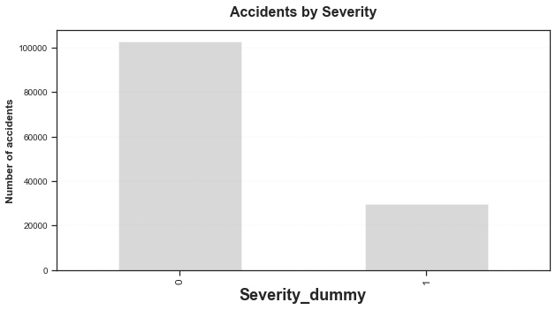
SMOTE resampling
Still Imbalanced Data
SMOTE (Synthetic Minority Oversampling TEchnique) consists of synthesizing elements for the minority class, based on those that already exist. It works randomly picking a point from the minority class and computing the k-nearest neighbors for this point. The synthetic points are added between the chosen point and its neighbors.

Slide 8
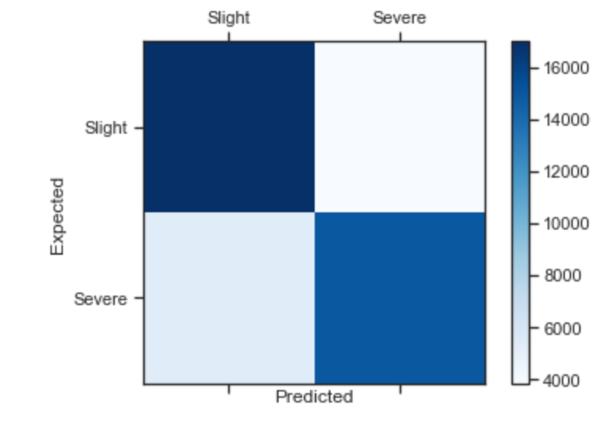
Random Forest model
Accuracy: 78.12%
Important factors:
Sex
Vehicle type
Causality class(Pedestrian, Driver, Passenger)
 | precision | recall | F-score
Slight | 0.76 | 0.82 | 0.79
Serious | 0.80 | 0.74 | 0.76

Slide 9
Decision Tree model
Accuracy: 72.01%
Important factors:
Sex
Vehicle type
 | precision | recall | F-score
Slight | 0.66 | 0.96 | 0.78
Serious | 0.91 | 0.49 | 0.63

Slide 10
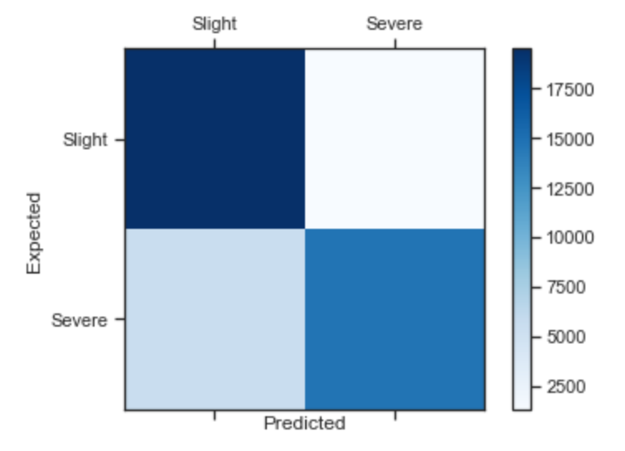
Final XGBoost model
Accuracy: 83.12%
Important factors:
Sex
Vehicle type
Area
 | precision | recall | F-score
Slight | 0.78 | 0.94 | 0.85
Serious | 0.92 | 0.72 | 0.81

Slide 11
Conclusions
We can predict severity of accident with 83.12% accuracy.
Factors that contribute:
Male drivers dominate in serious accidents (>70%);
People in 19-35 age range, considered as a risk group;
Fatal car accidents happen 2.4 times more in Rural area than in Urban;
Majority of accidents occur in good weather conditions;
Fatal car accidents tend to happen on roads with higher speed limits.

